Slide 1
Creating Posters using Powerpoint
Edited from:
Dr. Karen Wilson Department of Environmental Science
University of Southern Maine

Slide 2
Basic components checklist
Reads left to right, generally.
Figures (photos, graphs, maps, drawings) with captions
Richmond Logo Abstract
Introduction/Background
Methods
Results
Discussion/Conclusion/Next steps
References
Acknowledgements
Possibly Tables

Slide 3
Before you begin, set your poster dimensions
Powerpoint
Go to Design tab and select Page Setup (left side)
Under “Slides sized for”, select “Custom”
Set:
Width = 40 inches (4 ft)
Height = 30 inches (3 ft)
We are printing smaller posters than some, if you find you have more data you would like to display and not enough space you can make a larger poster. Use the guidelines from the TLC.

Slide 4
A very simple poster layout (see next slide)
A basic layout for a science poster. You could use less text!
Abstracts are not required if you need more space.
Blue square are spaces for figures (graphs, photos, maps) or tables (use tables sparingly if at all).
Always remember to include a descriptive caption for your figures and tables, and cite them (refer to them) in your text.
Rearrange the text and figure boxes as needed.

Slide 5
Layout
3/8/2012
Feature figures! (photos, graphs, maps, drawings)
Put the most important sections in the center of the poster, or up high where it will draw the viewer s eye
You can block out text sections, or just use the text boxes to line up you text, then remove the lines.
’

Slide 6
backgrounds
Don’t use flashlight‐style or photos as background
there is a risk of pixilation when printed
photos distract the reader

Slide 7
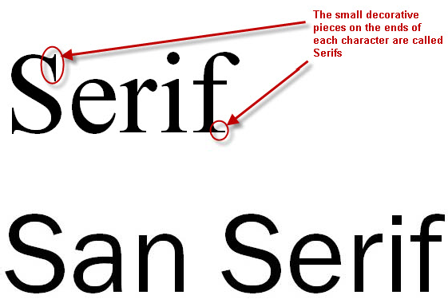
fonts
Shy people should be able to stand 8 ft away and still be able to read your poster…
Use
sans serif fonts for readability
“ ”
– Arial, Calibri, comic sans, trebuchet, tahoma
Sizes‐ start with:
Text 30 point
Title Banner 90 point

Slide 8
Figures (maps, graphs, drawings, photos)
3/8/2012
Figures are the reason‐to‐be for posters! Feature them in your layout!
Make sure axes labels, numbers, etc are written in large fonts
Caption should contain enough information to interpret the figure without referring to the text.
Each figure (or table) should be numbered and cited in the text:
Text (in the results section) might read: “Webworms were most abundant in cherry trees (Figure 1).”
And the caption would read: “Figure 1. Webworm abundance.
Bars are the mean number of webworms found in each tree type.”
10

